Slide 1
Quest / Boss / Balancing Design
Manel Mourelo Montero

Slide 2
How quests are designed?
Implementing the quest.
Level structure.
The quest phase.
Under close scrutiny.
Working with other departments.

Slide 3
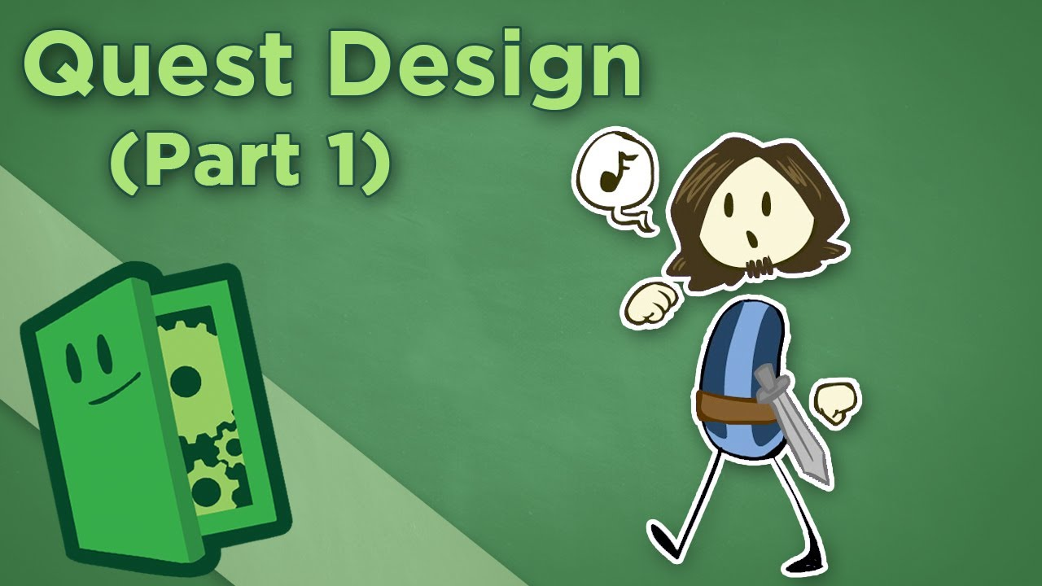
Points to take in count

Slide 4
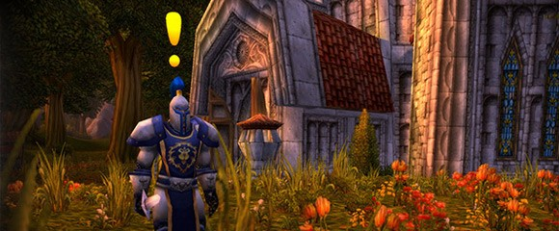
Step by Step process
1. Think of the plot, the characters, and what are the tasks for the player.

Slide 5
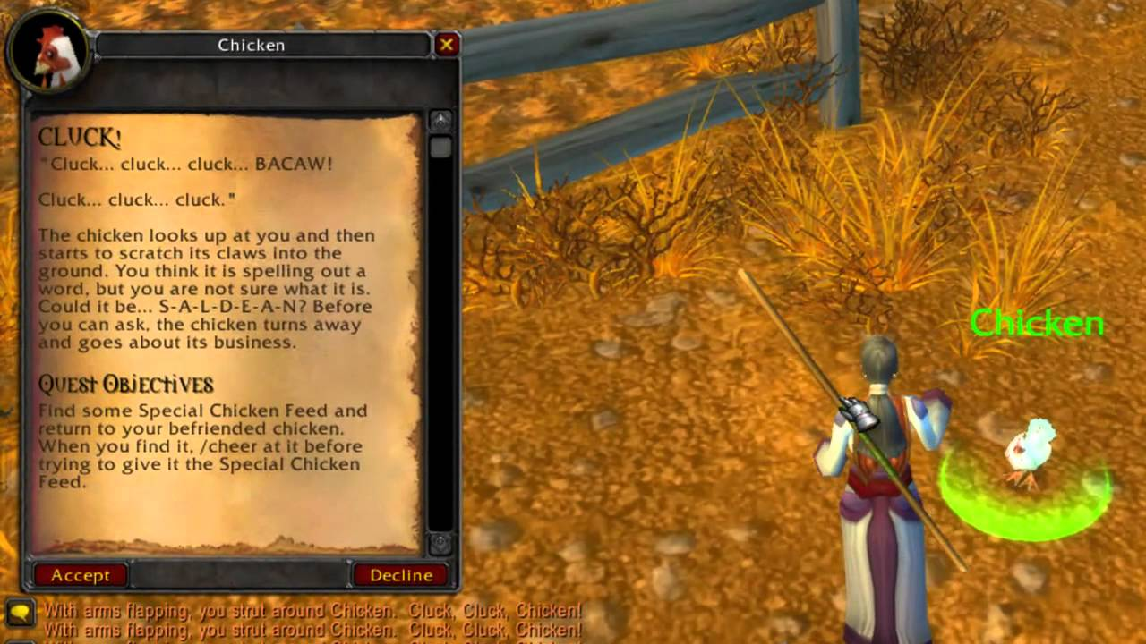
Step by Step process
2. Decide how the quest will start

Slide 6
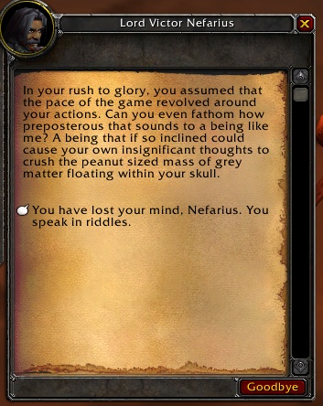
Step by Step process
3. Think about the body of the quest

Slide 7
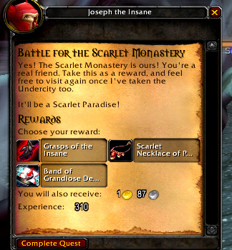
Step by Step process
4. Think about the quest ending or reward

Slide 8
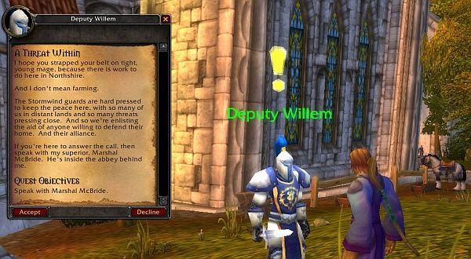
Step by Step process
5. Introductory paragraph

Slide 9
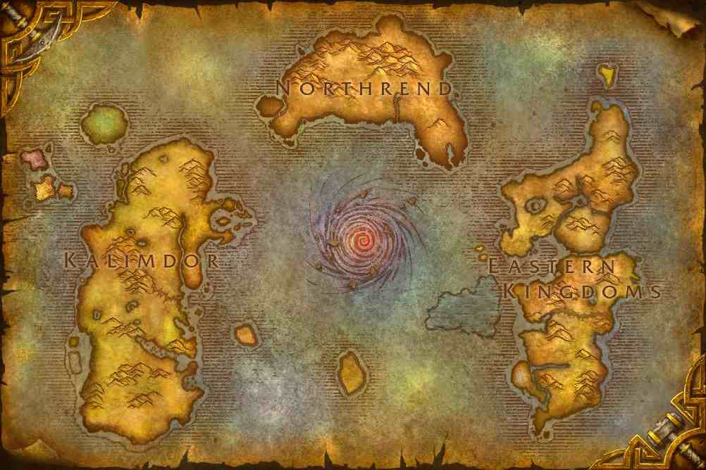
Step by Step process
6. Set up the location

Slide 10
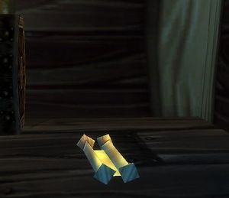
Step by Step process
7. Make all the content needed to do the quest

Slide 11

Common Mistakes

Slide 12
How bosses are designed?
Constant threat.
Puzzle.
Mastery.
Believability.
Learning curve.
Phases.
Aesthetics.

Slide 13

Points to take in count

Slide 14
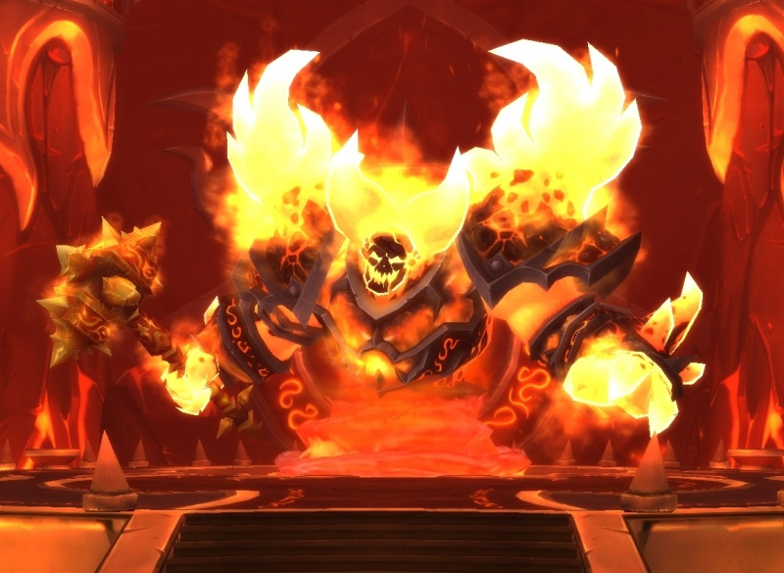
Step by Step process
1. Make sure the boss fits with the current level's theme

Slide 15
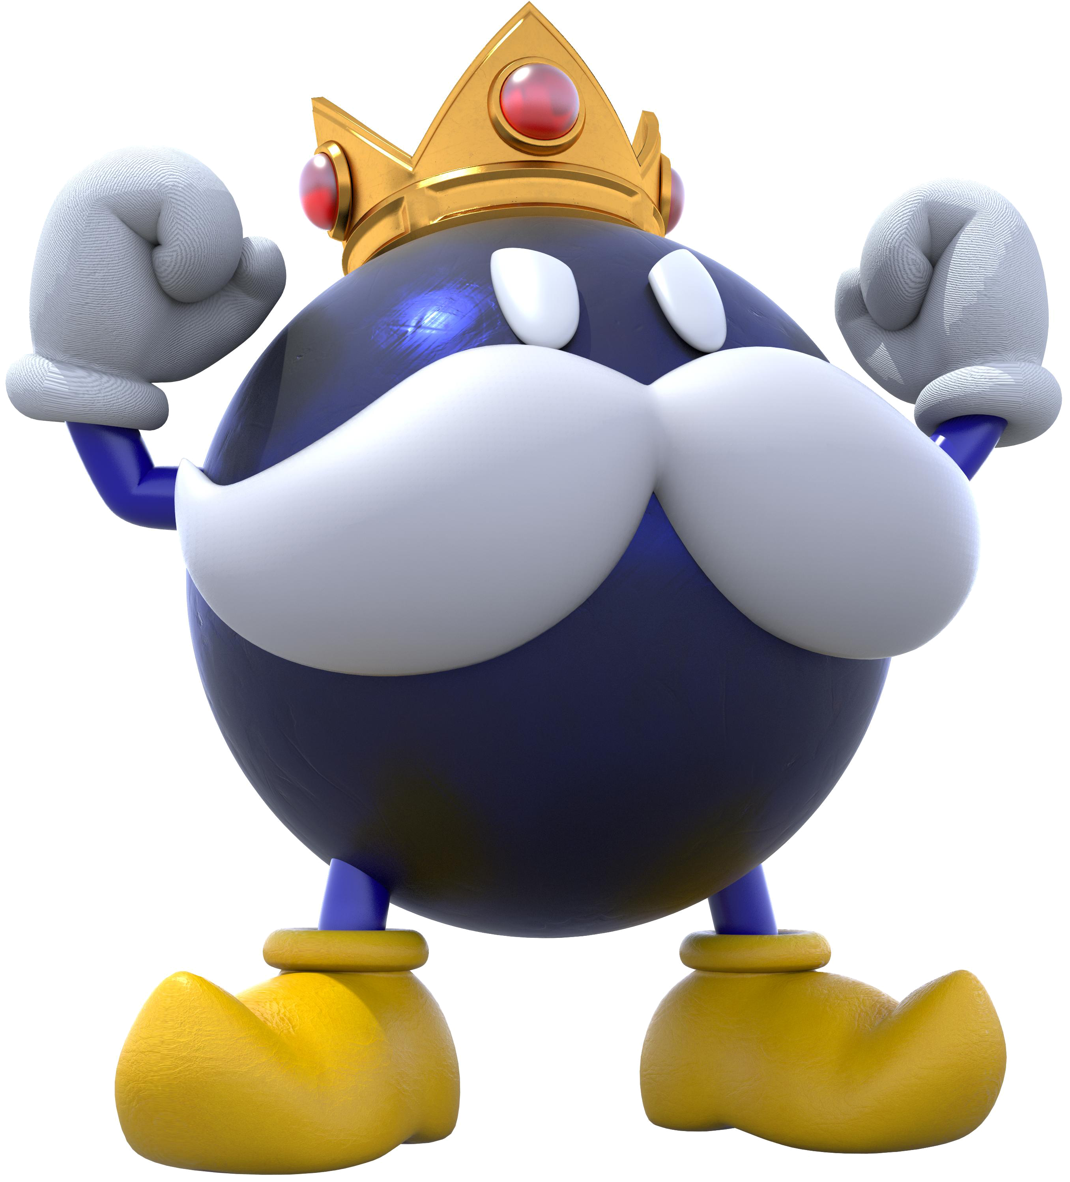
Step by Step process
2. Make sure it's harder than the average enemy

Slide 16
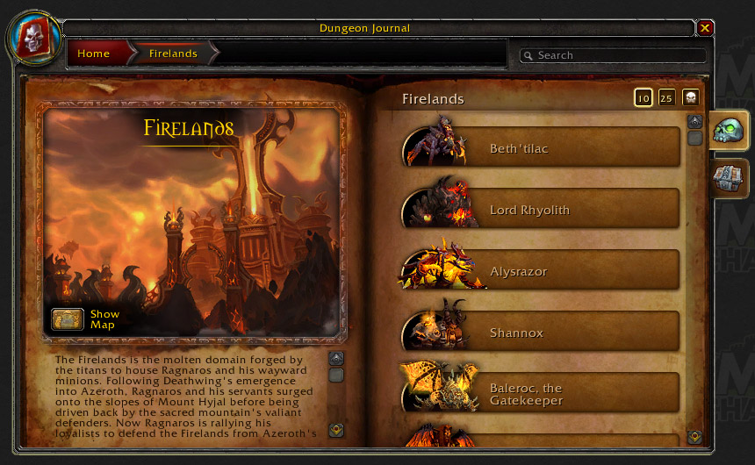
Step by Step process
3. How difficult the boss should be should depend on what point in the game it's encountered

Slide 17
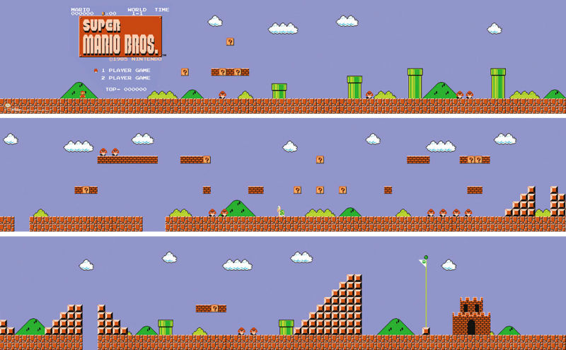
Step by Step process
4. Not every level has to have a boss

Slide 18
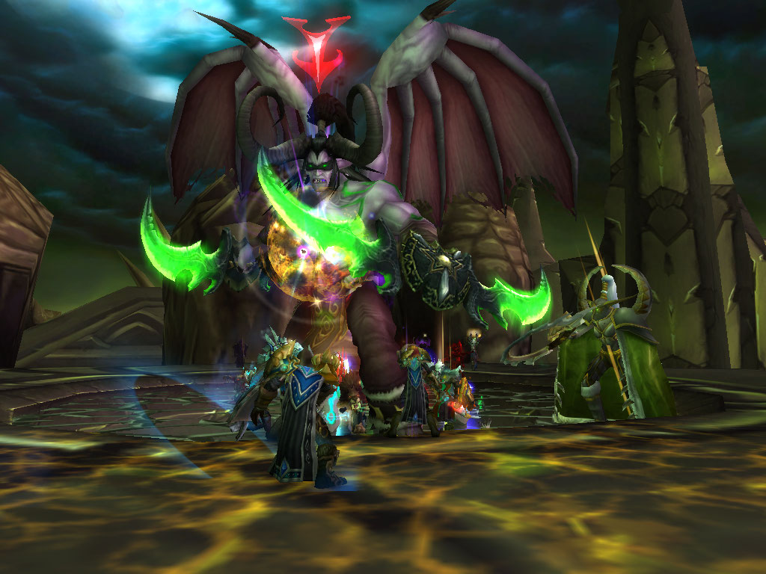
Step by Step process
5. Sometimes make the boss fight complex

Slide 19
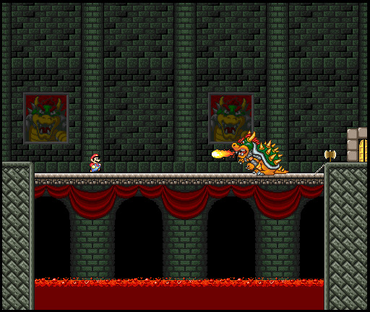
Step by Step process
6. Make sure the music changes from the normal level tune to the boss tune

Slide 20
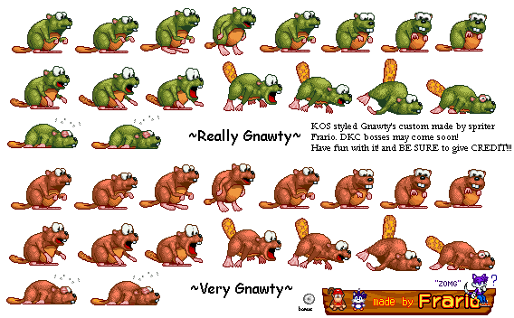
Step by Step process
7. If possible make every boss' tune its own

Slide 21
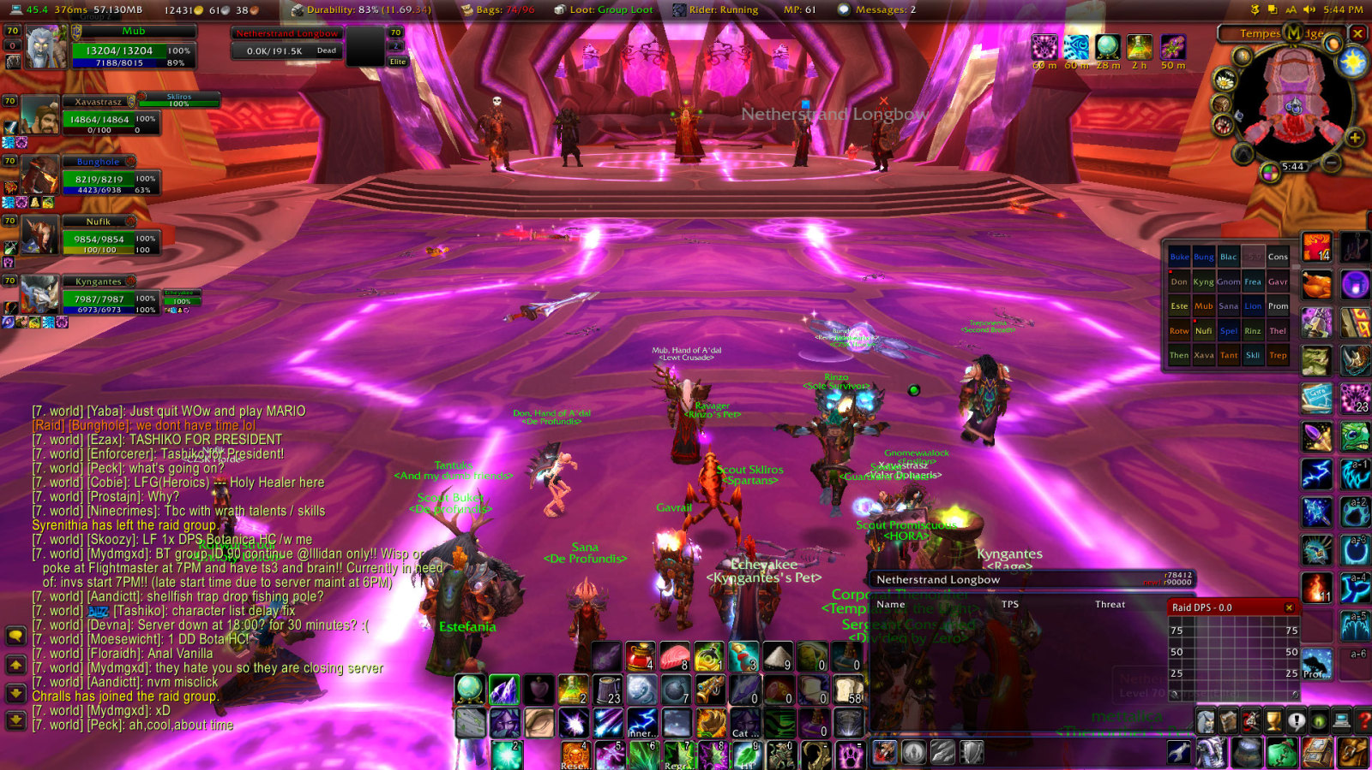
Step by Step process
8. Make sure as the boss' health gets lower it actually begins to vary its attacks

Slide 22
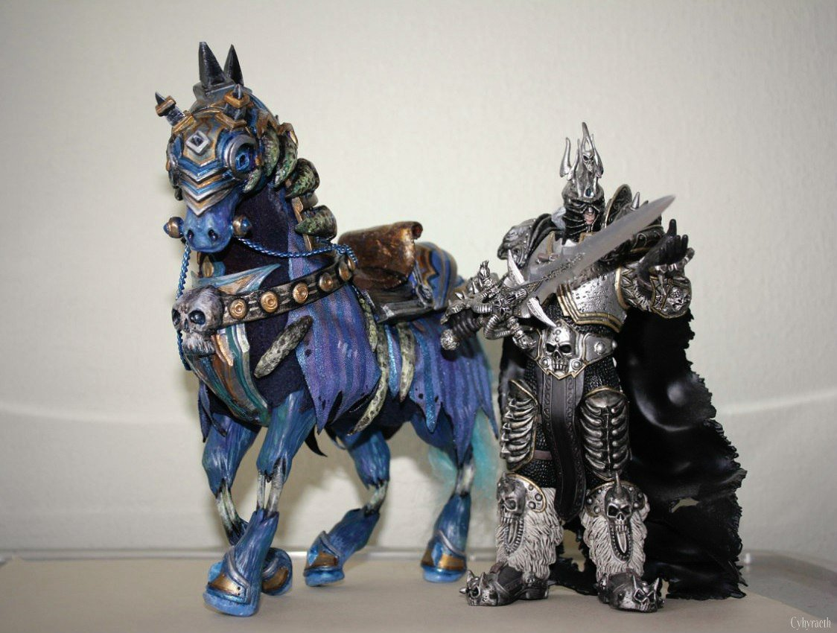
Step by Step process
9. Give the player a reason to fight your boss

Slide 23
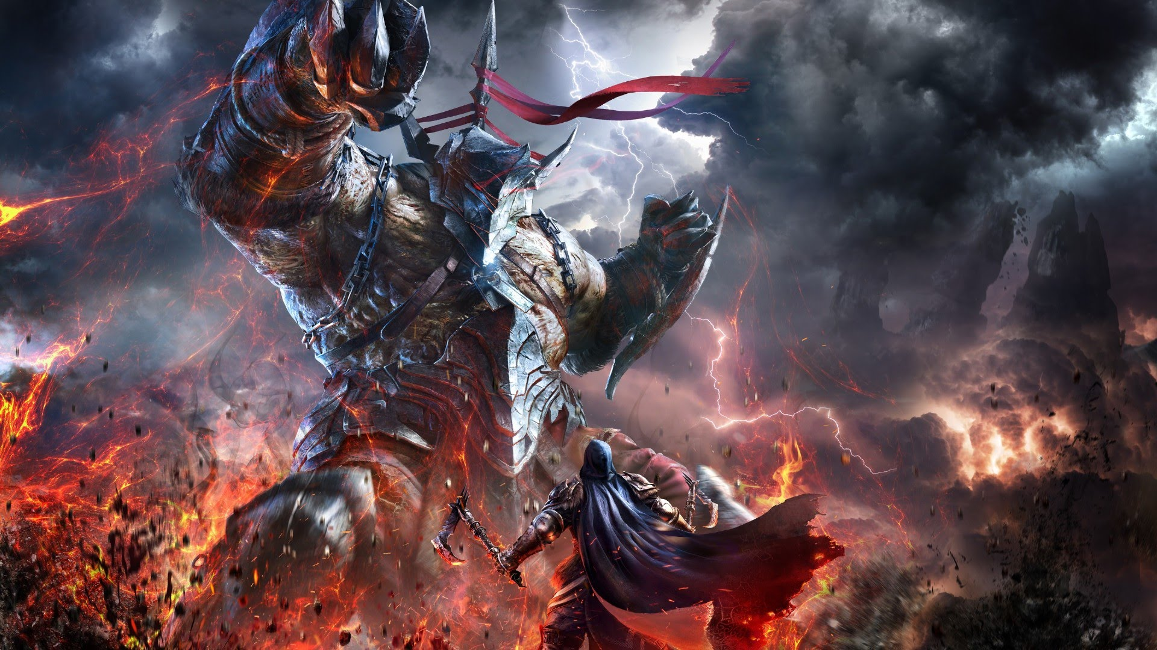
Step by Step process
10. Don't restrict yourself when making the boss

Slide 24
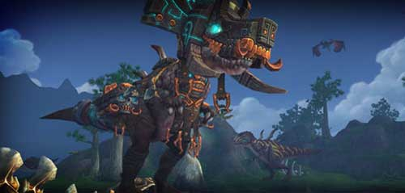
Common Mistakes

Slide 25
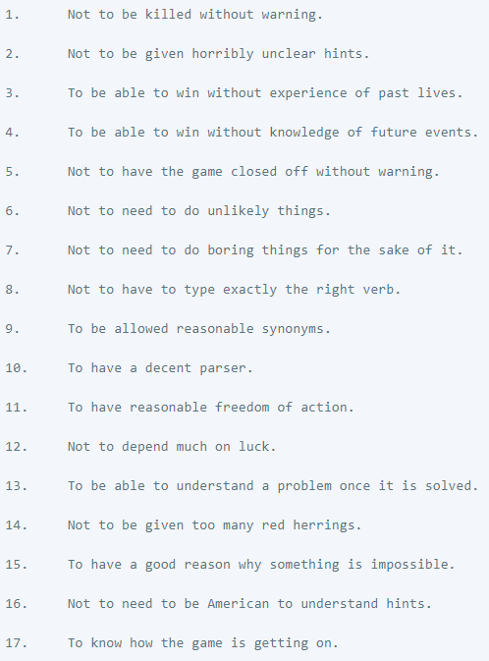
Balancing

Slide 26
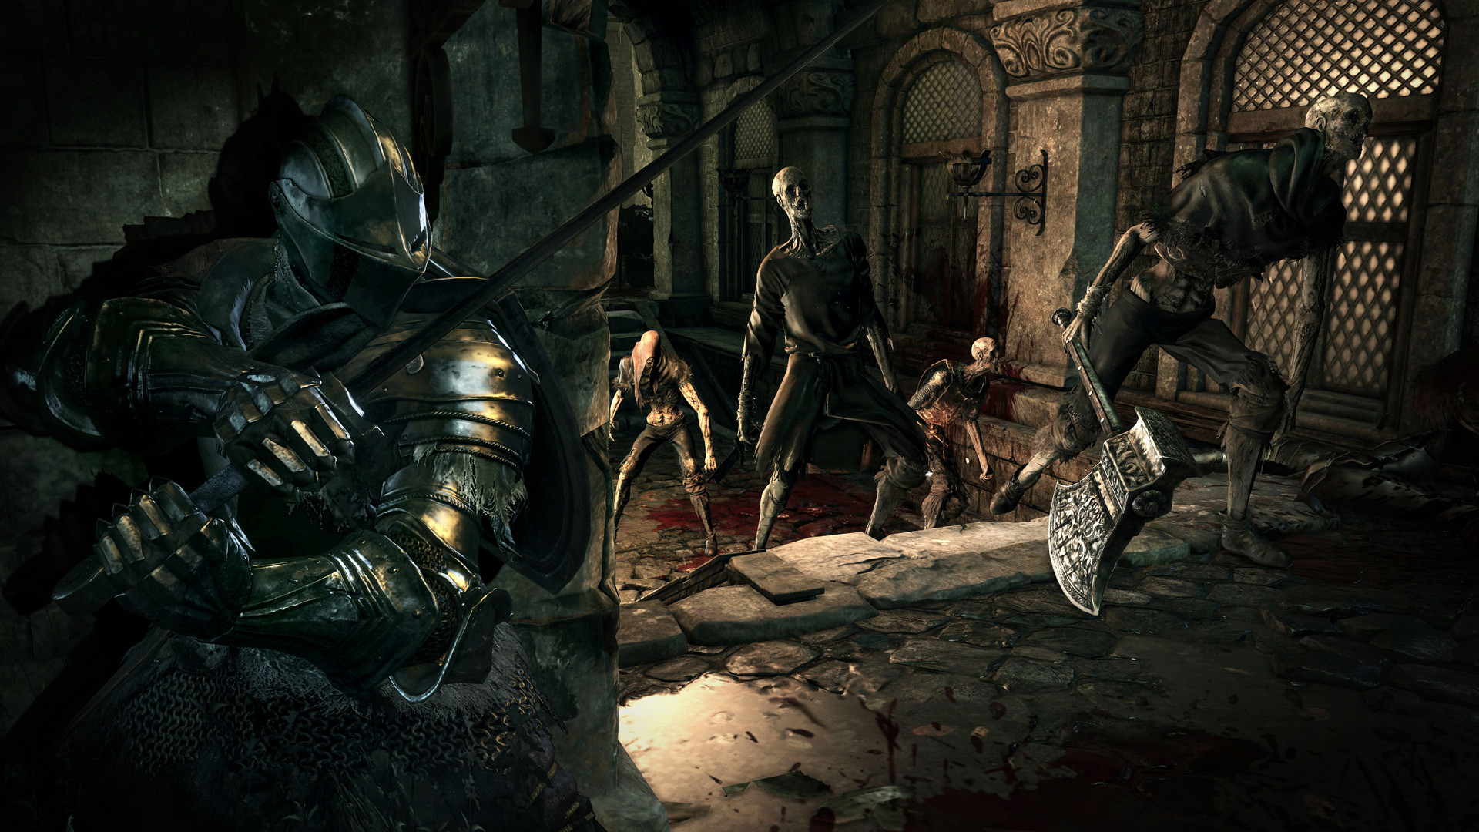
Balancing

Slide 27
Exercise
Think about the bosses you’ve enjoy the most and say why you think they were so good.

